Slide 1




VOICE ENABLED PATIENT DOCUMENTATION AND
ASSISTANCE SYSTEM
By Saraswathi Bavadharini S

Slide 2
AIM
Create user-friendly voice app for nurses, using NLP and speech recognition to streamline documentation.
Employ AI like GPT-3 for accurate patient summaries, enhancing usability.
Address challenges in data management, improving workflow and patient care delivery.

Slide 3
MOTIVATION
Optimize healthcare workflow by integrating speech recognition for quick patient data retrieval.
Enhance decision-making with automatic document summarization, improving efficiency.
Foster inclusivity with speech synthesis, promoting better communication and collaboration for improved patient outcomes.

Slide 4
ANALYSIS AND LITERATURE SURVEY
S.NO | PAPER TITLE | AUTHOR | RESEARCH QUES | METHODOLOGY | LIMITATION
1 | Benefits, Limits, and Risks of GPT-4 as an AI Chatbot for Medicine | Lee et al. (2023) | Using GPT 4 and similar Generative AI tools such as Google LaMDA and GPT 3.5 in Medical conversational ChatBOTs | ChatBOTs use the GPT 4 LLM to retrieve ansers for user queries from web and this model has been tested out and found to have an accuracy of over 90% | Authenticity of Data obtained from the web by GPT models.
2 | Speech emotion recognition using machine learning - A systematic review | Madanian et al. (2023) | Properties, methodology and working of SER model and analysing its efficiency . | Training a speech recognition (SR) system, including language corpus, nursing activities, clinical conversations etc | The paper may overlook non-ML approaches and interdisciplinary perspectives in SER

Slide 5
S.NO | PAPER TITLE | AUTHOR | RESEARCH QUES | METHODOLOGY | LIMITATION
3 | Development of the Speech- to-Text Chatbot Interface Based on Google API | Shakhovska et al. (2019) | Utilizing the Google Speech- to-Text API.data | The proposed method involves employing prefix functions and hashing algorithms for keyword searching and verb ending identification in chatbot conversation | The study may potentially overlook alternative methods and their effectiveness in real-world applications.
4 | Machine learning-based speech recognition system for nursing documentation – A pilot study | Lee et al. (2023) | Machine learning-based speech recognition (SR) system's effectiveness in reducing nursing documentation workloa | The study collected language corpus, nursing activities for SR system training in four sessions and achieved model had an accuracy score of 87.06% to 95.07% | findings are based on a pilot implementation in a psychiatry ward, potentially limiting generalizability to other nursing specialties or healthcare settings.
5 | The Capability of ChatGPT in Predicting and Explaining Common Drug- Drug Interactions | Juhi A et al. (2023) | Analyze ChatGPT in predicting and explaining common drug- drug interactions (DDIs) | Utilized 40 DDI lists from literature to converse with ChatGPT using two-stage questions | ChatGPT provided incomplete guidance at times, necessitating further improvement for patient use regarding DDI awareness.

Slide 6
S.NO | PAPER TITLE | AUTHOR | RESEARCH QUES | METHODOLOGY | LIMITATION
6 | Intelligent speech technologies for transcription, disease diagnosis, and medical equipment interactive control in smart hospitals: A review | Zhang et al. (2023) | To explore the application and potential of intelligent speech technology (IST) in addressing medical resource shortages | The paper introduces IST's procedure and system architecture, reviews its applications in smart hospitals, and presents a case study on stroke patient care | Challenges include noise interference and pronunciation differences, which may hinder the widespread application of IST in hospitals
4 | Deep Cross- Corpus Speech Emotion Recognition: Recent Advances and Perspectives | Zhang et al. (2021) | To comprehensivel y survey the state- of-the-art techniques in cross-corpus speech emotion recognition (SER) | The paper reviews existing literature on speech emotion databases, traditional methods for cross-corpus SER | Challenges such as natural data scarcity, multimodal integration, and limitations of deep learning techniques
5 | Natural Language Supervision for General-Purpose Audio Representati ons | Wang et al. (2023) | ProposeContrastive Language-Audio Pretraining (CLAP) forjoint audio-text representation | Utilize twoinnovative encodersfor audio and text, trained withContrastive Learning to create multimodalrepresentations. | Limitedevaluation on tasks with true Zero-Shot setup.

Slide 7
ANALYSIS
Improve accuracy in speech recognition and NLP for better usability.
Ensure adaptability to diverse healthcare environments for seamless integration.
Enhance security, privacy, and ethical considerations to maintain trust.

Slide 8
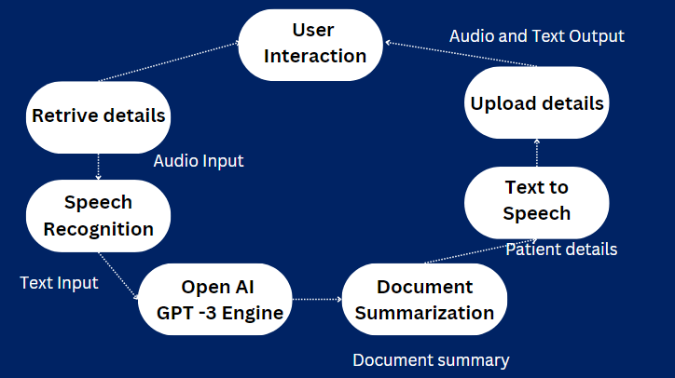
WORKING PRINCIPLE
Daniel Gallego
Lorna Alvarado

Slide 9
Speech Input: Utilizes the SpeechRecognition library to transcribe spoken input into text, enabling users to verbally command actions such as retrieving patient details.
AI Response Generation: Leverages OpenAI's GPT-3 model to generate responses based on prompts, allowing for natural language interaction and retrieval of patient information or document summaries
Document Summarization: Employs the Summarizer library to generate concise summaries of uploaded patient documents, enhancing accessibility and comprehension of medical records for healthcare professionals.

Slide 10
PROJECT DEMO

Slide 11
RESULT AND ANALYSIS
The implemented system successfully enables medical professionals to:
Retrieve patient details by voice command.
Upload medical documents for summarization.
Obtain summarized document content in both text and audio formats.
Experience streamlined workflow and enhanced efficiency in accessing patient information.

Slide 12
CONCLUSION AND FUTURE DEVELOPMENT
The Doctor's Assistant (Nurse) application demonstrates the potential of voice-enabled technology to streamline healthcare workflows. By integrating speech recognition, AI-driven response generation, and document summarization, it facilitates efficient retrieval of patient information and enhances decision-making processes for medical professionals..
FUTURE DEVELOPMENT
Enhanced Accuracy
Expanded Functionality
Interoperability
Personalization
Ethical Considerations:
01 - BRANDING
02 - WEBSITE
03 - SOCIAL MEDIA

Slide 13
THANK YOU

